Slide 1
Agile Mindset
Implementing Adaptive, fast, dynamic and highly flexible project management methodology

Slide 2
Software Development Lifecycle
Models

Slide 3
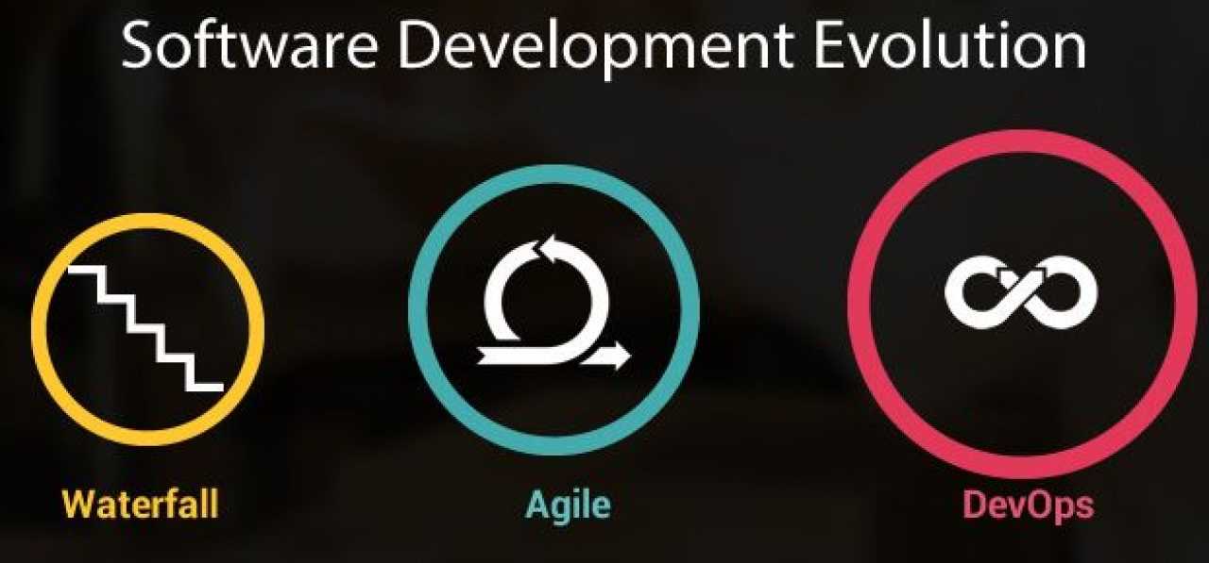

Slide 4
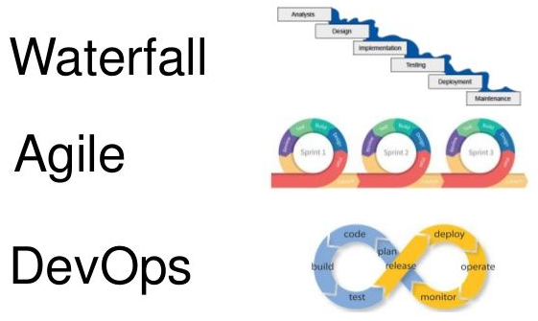

Slide 5
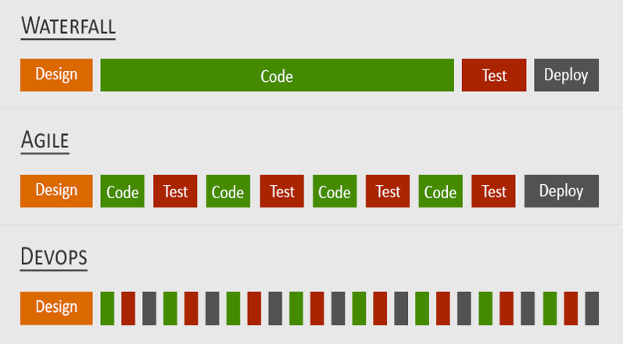

Slide 6
Waterfall
SDLC Models

Slide 7
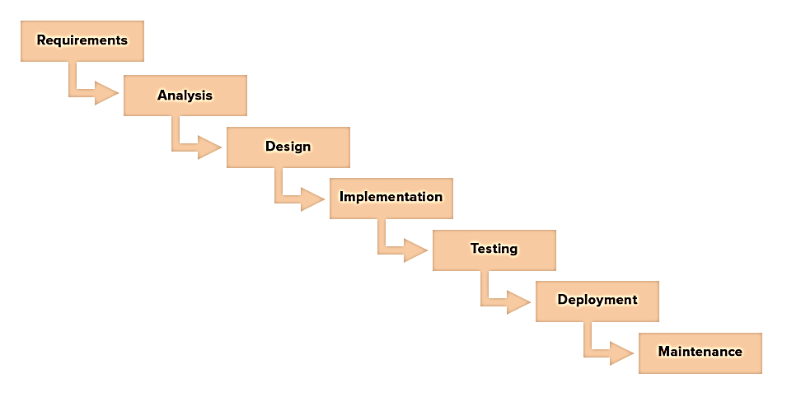

Slide 8
Waterfall Models Characteristics
Plan-driven approach.
Linear/Sequential approach to software development.
Results of each phase is one or more documents that are signed-off.
Following phase should not start until the previous phase has finished.
Must plan and schedule all the process activities before starting work on them.

Slide 9
The Waterfall method has several advantages, such as:
Ease of use: This model is easy to understand and use. The division between stages is intuitive and easy to grasp regardless of prior experience.
Structure: The rigidity of the Waterfall method is a liability, but can also be a strength. The clear demarcation between stages helps organize and divide work. Since you can't go back, you have to be "perfect" in each stage, which often produces better results.
Documentation: The sharp focus on gathering and understanding requirements makes the Waterfall model heavily reliant on documentation. This makes it easy for new resources to move in and work on the project when needed.

Slide 10
Disadvantages
Higher risk: The rigidity of this methodology means that if you find an error or need to change something, you have to essentially start the project from the beginning. This substantially increases the risk of project failure.
Front-heavy: The entire Waterfall approach depends heavily on your understanding and analyzing requirements correctly. Should you fail to do that - or should the requirements change - you have to start over. This lack of flexibility makes it a poor choice for long and complex projects.

Slide 11
It works best for the following project types:
Short, simple projects
Projects with clear and fixed requirements
Projects with changing resources that depend on in-depth documentation

Slide 12
Agile
SDLC Models

Slide 13
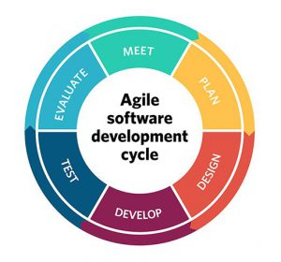
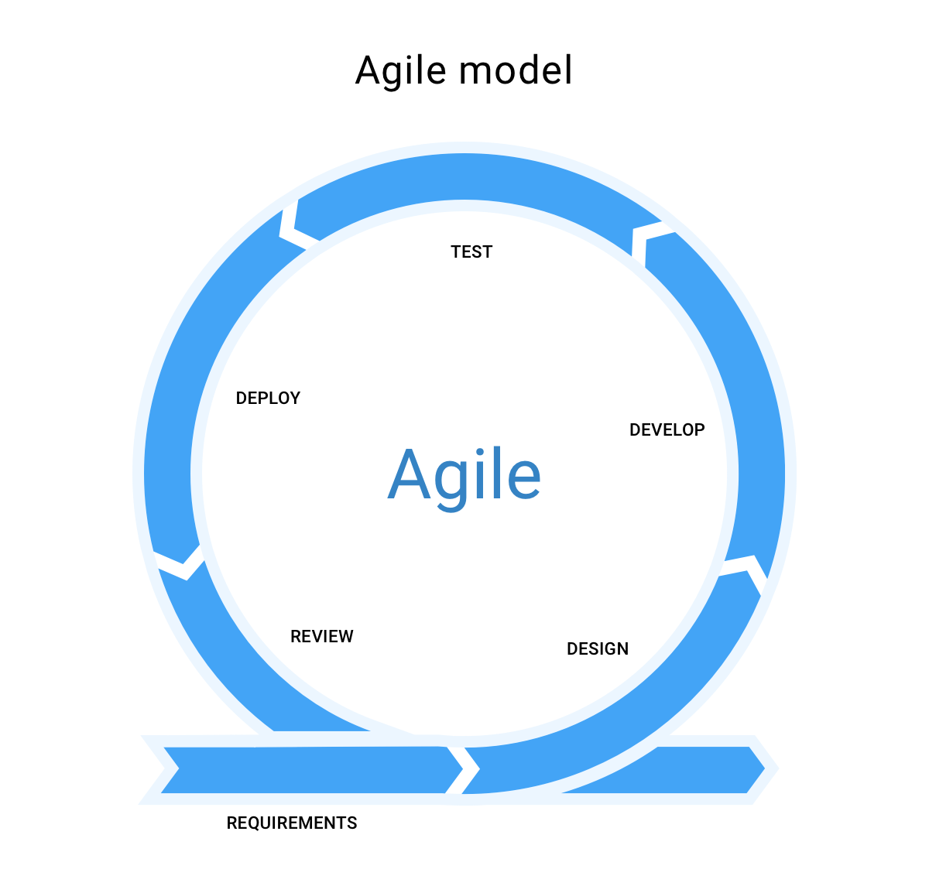

Slide 14
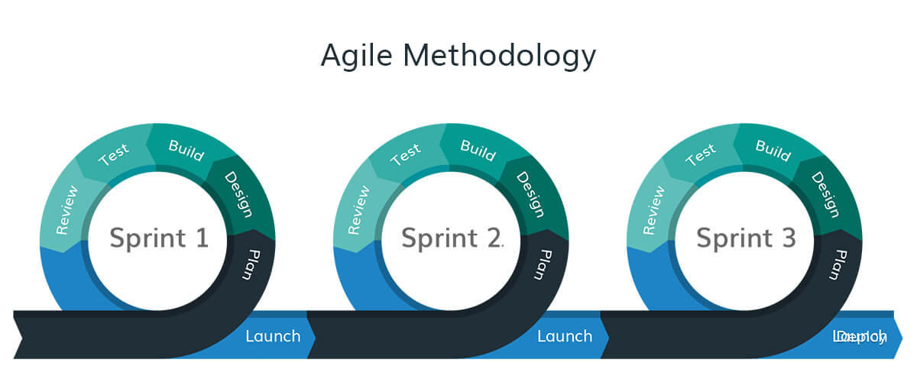

Slide 15
Characteristics
Focus on satisfying the customer through early and frequent releases of valuable software integrating the customer’s prioritized functionalities.
Welcome changing requirements even late in the development of the product.
Frequently delivering working software to customers.
Encourage collaboration between development teams, business people and customers.
Working software is the primary measure of progress.

Slide 16
Advantages:
Flexibility and freedom: Since there are no fixed stages or focus on requirements, it gives your resources much more freedom to experiment and make incremental changes. This makes it particularly well-suited for creative projects.
Lower risk: With Agile management, you get regular feedback from stakeholders and make changes accordingly. This drastically reduces the risk of project failure since the stakeholders are involved at every step.

Slide 17
Disadvantages:
No fixed plan: The Agile approach emphasizes responding to changes as they occur. This lack of any fixed plan makes resource management and scheduling harder. You will constantly have to juggle resources, bringing them on/off on an ad-hoc basis.
Collaboration-heavy: The lack of a fixed plan means all involved departments - including stakeholders and sponsors - will have to work closely to deliver results. The feedback-focused approach also means that stakeholders have to be willing (and available) to offer feedback quickly.

Slide 18
The flexibility of the Agile approach means that you can adapt it to different types of projects.
That said, this methodology works best for:
When you don't have a fixed end in mind but have a general idea of a product.
When the project needs to accommodate quick changes.
If collaboration and communication are your key strengths (and planning isn't)

Slide 19
Implementing Agile
Steps

Slide 20
Step 1:
Set your vision with a strategy meeting
At the beginning of a new Agile project, you need to define a clear business need or vision that your project is addressing. In essence, you need to answer why you’re doing what you’re setting out to do? It’s big picture stuff, but this is the core belief that you’ll refer back to as you build.
For product companies, one of the best ways to define your vision is to use what’s called the Elevator Pitch:
For: (Our Target Customer)
Who: (Statement of the Need)
The: (Product Name) is a (Product Category)
That: (Key Product Benefit, Compelling Reason to Buy and/or Use)
Unlike: (Primary Competitive Alternative)
Our Product: (Final Statement of Primary Differentiation)

Slide 21
Step 1:
Set your vision with a strategy meeting
Who should be there?
This is where you get buy-in on your project, so as many key stakeholders should be present, including relevant executives, managers, and directors, as well as all product owners.
When does it happen?
Your strategy meeting should happen before any project starts or at least annually to make sure your mission still is valid, with periodic meetings for updates.
How long should it take?
This is totally subjective, but a proper strategy meeting can take anywhere from 4–16 hours (just not in a row!)

Slide 22
Step 2:
Build out your product roadmap
Once your strategy has been validated it’s time for the product owner to translate that vision into a product roadmap. This is a high-level view of the requirements for your project with a loose timeframe for when you will develop each of them.
The ‘loose’ part here is important. You’re not spending days or weeks planning out every step, but simply identifying, prioritizing, and roughly estimating the effort each piece of your product will take on the way to making a usable product.

Slide 23
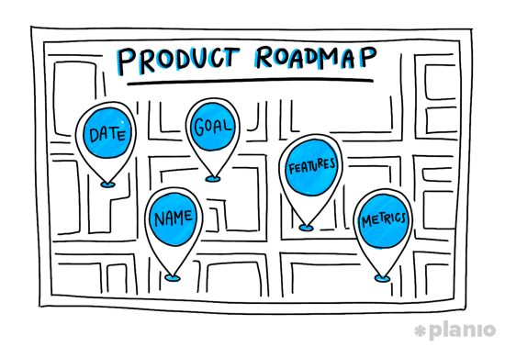
Step 2:
Build out your product roadmap
Work with a goal-oriented product roadmap, which is sometimes also referred to as theme-based:
“Goal-oriented roadmaps focus on goals, objectives, and outcomes like acquiring customers, increasing engagement, and removing technical debt. Features still exist, but they are derived from the goals and should be used sparingly. Use no more than three to five features per goal, as a rule of thumb.”
- Roman Pichler, Product Management Expert
For each of these goals, you want to include 5 key pieces of information: Date, Name, Goal, Features, and Metric

Slide 24
Step 2:
Build out your product roadmap
Who should be there?
The product roadmap is done by the Product Owner, but should also include buy-in and input from any other stakeholders in the project — think marketing, sales, support, and development team reps.
When does it happen?
The roadmap needs to be in place before you start planning out sprints, so it’s best to move into creating it directly after your strategy meeting.
How long should it take?
Like all things in Agile project management, you want to move quickly rather than dwell on early stage planning. However, your roadmap is a literal map from your mission to your MVP (Minimum Viable Product) and should take as long as it does to feel confident that you’ve covered all the applicable goals.

Slide 25
Step 3:
Get amped up with a release plan
At this stage, the product owner creates a high-level timetable for the release of working software. Because Agile projects will have multiple releases, you’ll want to prioritize the features needed to get you to launch first.
For example, if your project kicked off in November, you might set your MVP launch for early February, with a high-priority feature release the following May. This all depends on the complexity of your project and the lengths of your “sprints” — the periods of work dedicated to each goal (which we’ll get into next!). A typical release includes 3–5 of these sprints.

Slide 26
Step 3:
Get amped up with a release plan
Who should be there?
A release plan is like rallying the troops. The product owner, project managers, and all team members should be there. You can also bring in a few key stakeholders to add some additional oomph and get the team fired up.
When does it happen?
At a minimum, your release plans should be created on the first day of any new release and reviewed at least every quarter.
How long should it take?
Be realistic about how long a release will take, but don’t let that slow you down. A typical release planning session should take around 4–8 hours.

Slide 27
Step 4:
It’s time to plan out your sprints
It’s time to move from the macro to the micro view as the product owner and development team plan “sprints” — short cycles of development in which specific tasks and goals will be carried out. A typical sprint lasts between 1–4 weeks and should remain the same length throughout the entire project as this enables teams to plan future work more accurately based on their past performance.
At the beginning of a sprint cycle, you and your team will create a list of backlog items you think you can complete in that timeframe that will allow you to create functional software. Then, it’s as simple as using one of the Agile methodologies to work through them.

Slide 28
Step 4:
It’s time to plan out your sprints
Who should be there?
Sprint planning is a team effort, and therefore the product owner, project managers, and all team members should be present to voice their thoughts and concerns.
When does it happen?
Sprint planning takes place at the start of each sprint cycle. For example, if you’re doing weekly sprints, you’ll do a planning session every Monday (or whatever day of the week you choose to start on).
How long should it take?
Sprint planning sets the tone for the cycle. So while you don’t want to spend too much time at this stage, it could realistically take you 2–4 hours. But once you’ve planned your sprint you’re quite literally off to the races.

Slide 29
Step 5:
Keep your team on track with daily standups
Throughout every sprint you need opportunities to make sure no roadblocks are creeping up and getting in the way of completing your goals on time. That’s where the daily meeting, or “Standup” in Agile-speak, comes in.
A standup is a daily, 15-minute meeting where your team comes together to discuss three things:
What did you complete yesterday?
What are you working on today?
Are there any roadblocks getting in the way?
While this might seem like an annoyance to some of your team, these meetings are essential for fostering the kind of communication that drives Agile project management. Agile depends on reacting quickly to issues and voicing them in a public space is a powerful way to foster cross-team collaboration.

Slide 30
Step 6:
Sprint’s done? It’s time for a review
If everything has gone as planned, by the end of your sprint cycle you should have a functioning piece of software. At this point, it’s time to review what was done and show this off to people on your team and any key stakeholders. Think of it as Agile show-and-tell.
The key here is to check your initial plan to make sure that all requirements were met. As the product owner, it’s your choice to accept or refuse certain functionalities. If something went wrong, ask why? How can you adjust the next sprint so your team can hit their targets? Agile is all about continuous learning and iterations, and this means on your processes as well as your product.

Slide 31
Step 6:
Sprint’s done? It’s time for a review
Who should be there?
Your entire team as well as any key stakeholders should be at your sprint review to check in on progress and voice their support.
When does it happen?
The sprint review takes place at the end of each sprint.
How long should it take?
Just say no to lengthy slides and feature dissertations. The sprint review should only take an hour or two max.

Slide 32
Step 7:
What’s next? Decide what to focus on in your sprint retrospective
For Agile project management to work, you need to have a clear next step after each step. This is determined during your sprint retrospective. Once a sprint has been completed and features have been shown off, it’s time to decide what work gets done next. Did you learn something during the sprint that changes your initial timeline or vision for the project?
Don’t simply plan, but also take this time to discuss how the previous sprint went and how you could improve in your next one.

Slide 33
Step 7:
What’s next? Decide what to focus on in your sprint retrospective
Who should be there?
The retrospective is a natural extension of the review, and so while your stakeholders can leave, the rest of the team should be involved and giving their insights.
When does it happen?
It makes the most sense for your sprint retrospective to happen right after your sprint review.
How long should it take?
Again, keep it short and sweet. An hour or two max is probably all you’ll need to debrief and plan for the next brief.

Slide 34
What happens now?
After Agile sprints

Slide 35
What happens now?
At this point, you should have a functional piece of software you can ship, get feedback on, and plan new features or fixes for.
This continuous shipping, learning, and building is what makes Agile so powerful. Rather than simply working through your backlog, you’re releasing products and seeing how people interact with them.
This means rather than work on a product for a year only to release it and find out some core functionality is missing, you could potentially figure that out after a sprint and adjust accordingly.

Slide 36
Agile Development
Elements in product software engineering

Slide 37
Integrate the following into your software project development:
Version Tracker and Version Control Systems
Collaboration Platforms
Coding Standards and Team Norms
Test-Driven Development (TDD)
Modular programming
Software Quality Assurance

Slide 38
Tools
More tools for the agile implementor

Slide 39
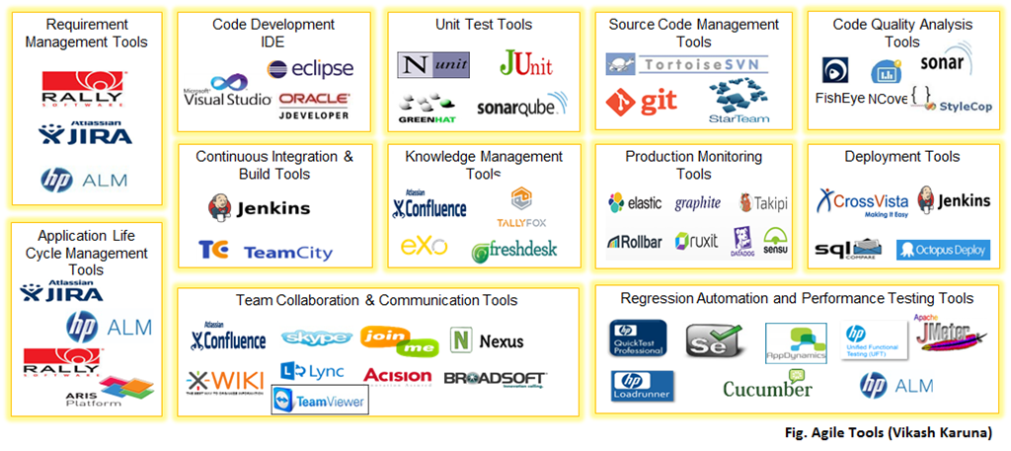

Slide 40
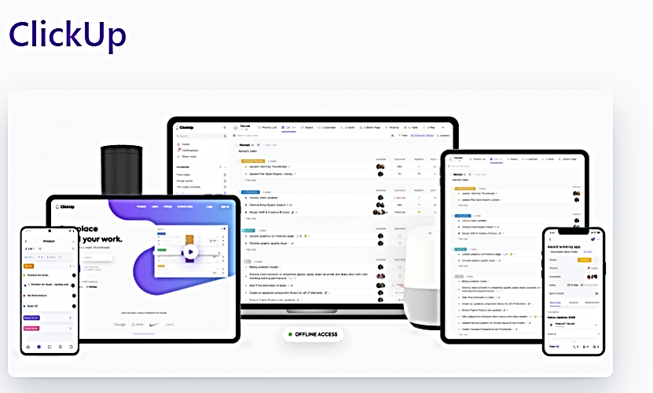

Slide 41
ClickUp Agile Software Features:
Epics: set up milestones along with sprint planning
Story Points: understand how to improve your Agile project with this ClickApp
Sprints: Use the Sprints ClickApp to manage your sprint’s dates, statuses, tasks, automations, and more!
Dashboards: have all your Agile metrics like Burnup Chart, Velocity Chart, and Cumulative Flow Diagrams ready for the sprint planning and sprint review meetings
Docs: document your engineering wiki, product backlog and sprint backlog to share it with stakeholders
Templates: save time by using pre-made project templates
Custom Task Statuses: customize your workflow easily
Tags: organize your Agile project with custom tags
Goals: set easy-to-track Targets within each sprint Goal
Time Tracking: stay in control of how long you spend on each task
Integrations: add your favorite tools like Slack, Gitlab, and Google Drive to your workspace
Apps: fully functional apps for Android, iOS, Mac, Windows, and Linux

Slide 42
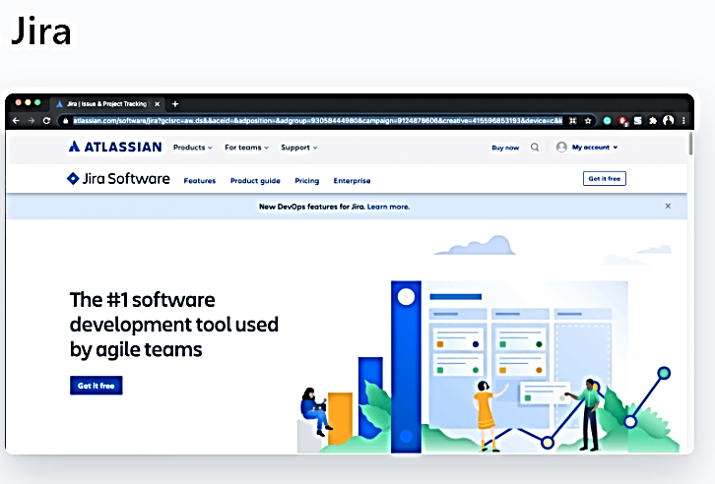

Slide 43
JIRA Agile Software Features:
Issue tracking
Boards
Epics
Bug tracking
Custom fields
Pricing: Free to $14 per user/per month

Slide 44
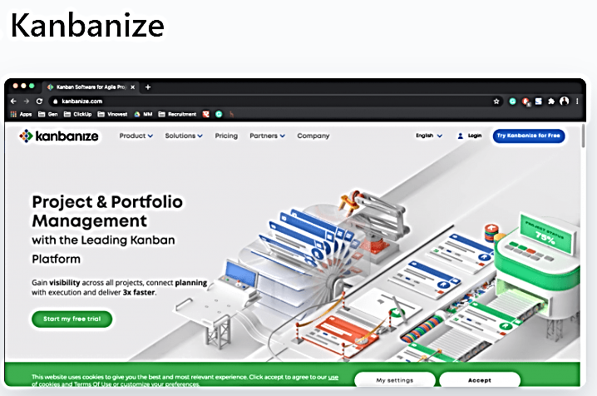

Slide 45
Kanbanize Agile Software Features:
Timeline Workflow for Agile planning
Customizable Kanban boards and cards to show different user stories
Kanban card links for work-breakdown structure and visualizing dependencies
Built-in templates for Kanban board views
Manage multiple workflows on one Kanban board
Management workspaces for scaling Kanban across the organization
Business automation rules
Pricing: Starting from $149/month to $179/month for 15 users

Slide 46
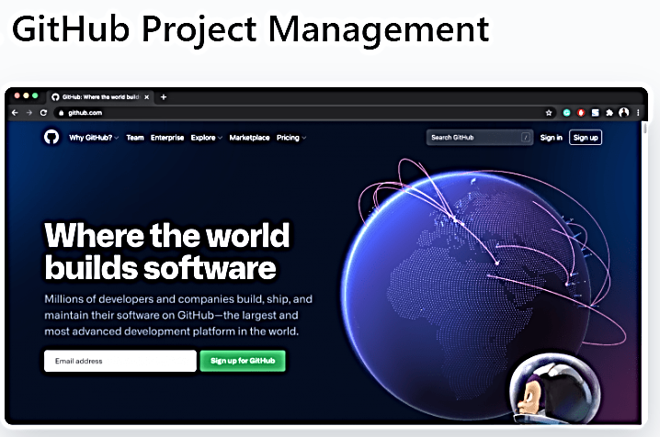

Slide 47
GitHub Agile Software Features:
Issue tracking
Mentions for teamwork
Labels
Link issues and pull requests
Pricing: Free to $21 per user/per month

Slide 48
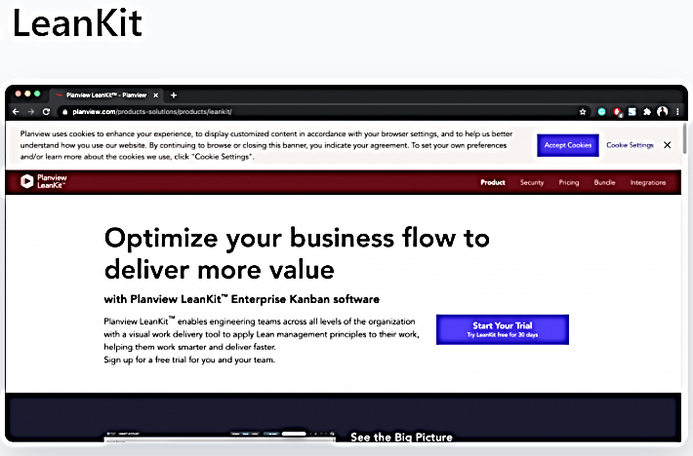

Slide 49
LeanKit Agile Software Features:
Task templates
Kanban boards
Track issues and bugs during Agile testing phases
Manage project portfolios
Lean metrics and reporting
Pricing: Free to $20 per user/month

Slide 50
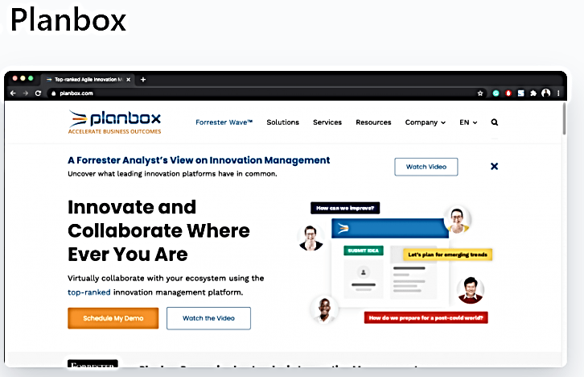

Slide 51
Planbox Agile Software Features:
Time estimates to prioritize backlog items
Share project with outsider collaborators
Detailed analytics
Planbox Work Management API to support cross-platform support
Pricing: Contact Planbox for pricing details

Slide 52
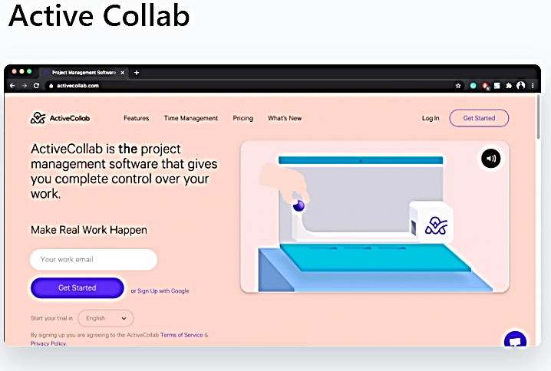

Slide 53
ActiveCollab Agile Software Features:
Labels
Project progress
Set recurring tasks
Workload reports
Pricing: $6.25 per user/month

Slide 54
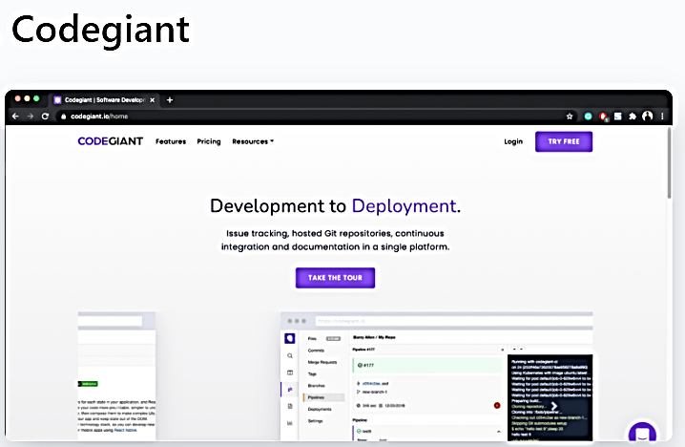

Slide 55
CodeGiant Agile Software Features:
Effortless task management with its drag and drop functionality
Built-in Scrum board
Roadmaps
Reports
Pricing: Free to $6/user/month.

Slide 56
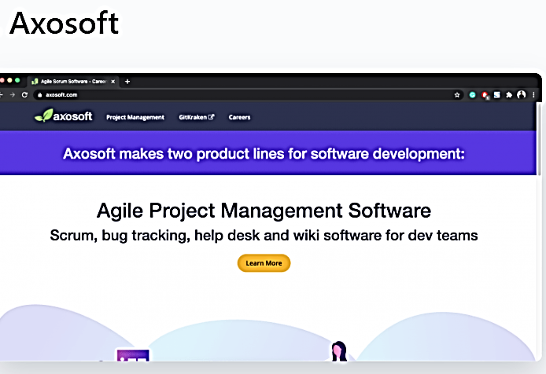

Slide 57
Axosoft Agile Software Features:
Time estimates
Product backlog management
Daily Scrum mode
Burndown charts
Pricing: Starts from $20.83/5 users

Slide 58
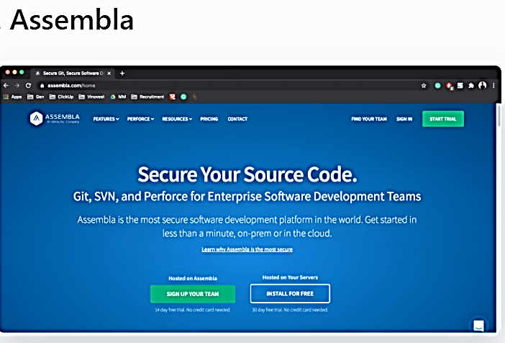

Slide 59
Assembla Agile Software Features:
Git integrations
Repo integrations
Product backlog management
Supports Git, SVN & Perforce
Pricing: $12 per user/month to $960/year for five users

Slide 60
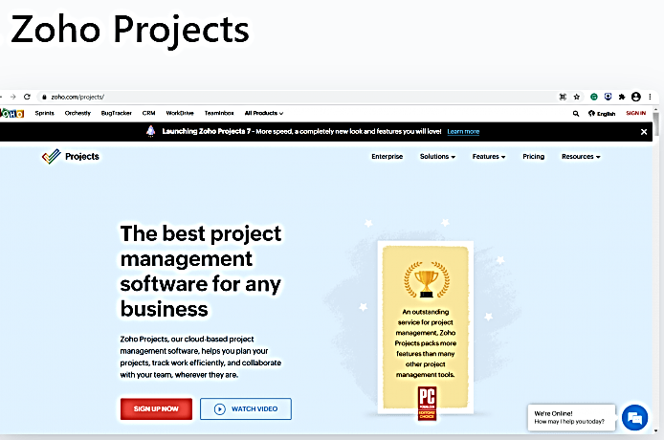

Slide 61
Zoho Agile Software Features:
Gantt charts
Project planning
Chat, Feed, and Forum for communication
Task reports
Integrations for bug tracking
Pricing: Free to $9 per user/month

Slide 62
Agile Manifesto
https://agilemanifesto.org/

Slide 63

SCRUM
Management framework

Slide 64
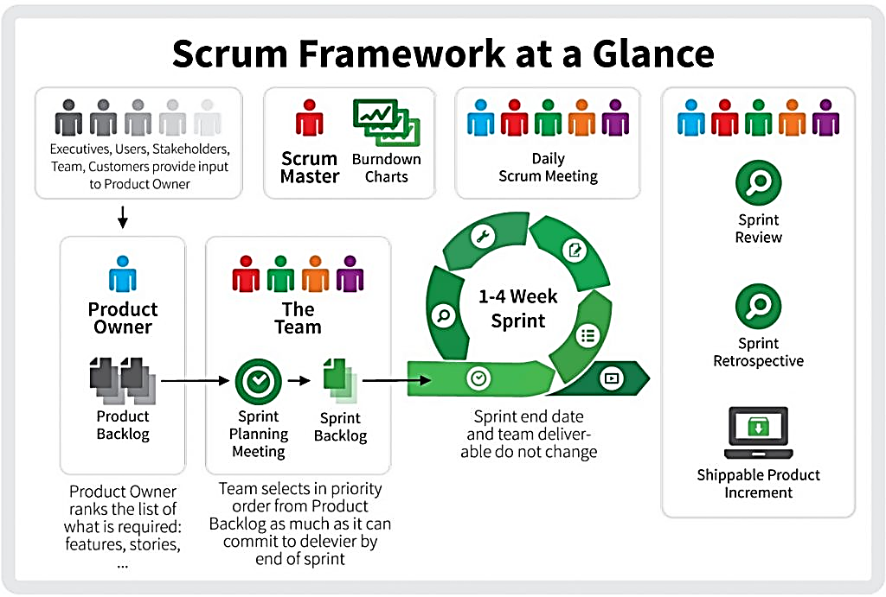

Slide 65
SCRUM?
Scrum is a framework within which people can address complex adaptive problems, while productively and creatively delivering products of the highest possible value.
Scrum is a lightweight framework that helps people, teams and organizations generate value through adaptive solutions for complex problems.

Slide 66

SCRUM?
In a nutshell, Scrum requires a Scrum Master to foster an environment where:
A Product Owner orders the work for a complex problem into a Product Backlog.
The Scrum Team turns a selection of the work into an Increment of value during a Sprint.
The Scrum Team and its stakeholders inspect the results and adjust for the next Sprint.
Repeat

Slide 67
The Scrum Framework
Scrum is simple. It is the opposite of a big collection of interwoven mandatory components. Scrum is not a methodology. Scrum implements the scientific method of empiricism.
  Empiricism, in philosophy, the view that all concepts originate in experience, that all concepts are about or applicable to things that can be experienced, or that all rationally acceptable beliefs or propositions are justifiable or knowable only through experience.
Scrum replaces a programmed algorithmic approach with a heuristic one, with respect for people and self-organization to deal with unpredictability and solving complex problems.

Slide 68
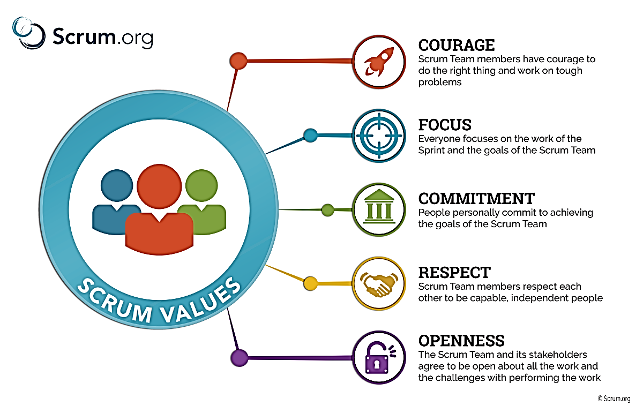
The Scrum Values

Slide 69
The Scrum Team
The fundamental unit of Scrum is a small team of people, a Scrum Team. The Scrum Team consists of one Scrum Master, one Product Owner, and Developers.
Within a Scrum Team, there are no sub-teams or hierarchies. It is a cohesive unit of professionals focused on one objective at a time, the Product Goal.

Slide 70
The Scrum Events
Prescribed events are used in Scrum to create regularity and to minimize the need for meetings not defined in Scrum. All events are time-boxed.
Once a Sprint begins, its duration is fixed and cannot be shortened or lengthened. The remaining events may end whenever the purpose of the event is achieved, ensuring an appropriate amount of time is spent without allowing waste in the process.
The Scrum Events are:
Sprint
Sprint Planning
Daily Scrum
Sprint Review
Sprint Retrospective

Slide 71

What is a Sprint?

Slide 72
Sprint
Sprints are the heartbeat of Scrum, where ideas are turned into value.
They are fixed length events of one month or less to create consistency. A new Sprint starts immediately after the conclusion of the previous Sprint.
All the work necessary to achieve the Product Goal, including Sprint Planning, Daily Scrums, Sprint Review, and Sprint Retrospective, happen within Sprints.
During the Sprint:
No changes are made that would endanger the Sprint Goal;
Quality does not decrease;
The Product Backlog is refined as needed; and,
Scope may be clarified and renegotiated with the Product Owner as more is learned.
Sprints enable predictability by ensuring inspection and adaptation of progress toward a Product Goal at least every calendar month. When a Sprint’s horizon is too long the Sprint Goal may become invalid, complexity may rise, and risk may increase. Shorter Sprints can be employed to generate more learning cycles and limit risk of cost and effort to a smaller time frame. Each Sprint may be considered a short project.

Slide 73
What is Sprint Planning?

Slide 74
Sprint
Planning
Topic One: Why is this Sprint valuable?
The Product Owner proposes how the product could increase its value and utility in the current Sprint. The whole Scrum Team then collaborates to define a Sprint Goal that communicates why the Sprint is valuable to stakeholders. The Sprint Goal must be finalized prior to the end of Sprint Planning.

Slide 75
Sprint
Planning
Topic Two: What can be Done this Sprint?
Through discussion with the Product Owner, the Developers select items from the Product Backlog to include in the current Sprint. The Scrum Team may refine these items during this process, which increases understanding and confidence.
Selecting how much can be completed within a Sprint may be challenging. However, the more the Developers know about their past performance, their upcoming capacity, and their Definition of Done, the more confident they will be in their Sprint forecasts.

Slide 76
Sprint
Planning
Topic Three: How will the chosen work get done?
For each selected Product Backlog item, the Developers plan the work necessary to create an Increment that meets the Definition of Done. This is often done by decomposing Product Backlog items into smaller work items of one day or less. How this is done is at the sole discretion of the Developers. No one else tells them how to turn Product Backlog items into Increments of value.
The Sprint Goal, the Product Backlog items selected for the Sprint, plus the plan for delivering them are together referred to as the Sprint Backlog.
Sprint Planning is timeboxed to a maximum of eight hours for a one-month Sprint. For shorter Sprints, the event is usually shorter.

Slide 77
Sprint
Planning
The Sprint Goal, the Product Backlog items selected for the Sprint, plus the plan for delivering them are together referred to as the Sprint Backlog.
Sprint Planning is timeboxed to a maximum of eight hours for a one-month Sprint. For shorter Sprints, the event is usually shorter.

Slide 78
What is a Daily Scrum?

Slide 79

Daily
SCRUM
The purpose of the Daily Scrum is to inspect progress toward the Sprint Goal and adapt the Sprint Backlog as necessary, adjusting the upcoming planned work.
The Daily Scrum is a 15-minute event for the Developers of the Scrum Team. To reduce complexity, it is held at the same time and place every working day of the Sprint. If the Product Owner or Scrum Master are actively working on items in the Sprint Backlog, they participate as Developers.

Slide 80
Daily
SCRUM
The Developers can select whatever structure and techniques they want, as long as their Daily Scrum focuses on progress toward the Sprint Goal and produces an actionable plan for the next day of work. This creates focus and improves self-management.
Daily Scrums improve communications, identify impediments, promote quick decision-making, and consequently eliminate the need for other meetings.
The Daily Scrum is not the only time Developers are allowed to adjust their plan. They often meet throughout the day for more detailed discussions about adapting or re-planning the rest of the Sprint’s work.

Slide 81
Daily
SCRUM
The Role of the Scrum Master During the Daily Scrum
The Scrum Master ensures that the meeting happens, but the Developers are responsible for conducting the Daily Scrum. The Scrum Master teaches them to keep the Daily Scrum within the 15-minute time-box.
The Daily Scrum is an internal meeting for the Scrum Team. If others are present, the Scrum Master ensures that they do not disrupt the meeting.

Slide 82
What is a Sprint Review?

Slide 83

Sprint
REview
The purpose of the Sprint Review is to inspect the outcome of the Sprint and determine future adaptations. The Scrum Team presents the results of their work to key stakeholders and progress toward the Product Goal is discussed.
During the event, the Scrum Team and stakeholders review what was accomplished in the Sprint and what has changed in their environment. Based on this information, attendees collaborate on what to do next. The Product Backlog may also be adjusted to meet new opportunities. The Sprint Review is a working session and the Scrum Team should avoid limiting it to a presentation.
The Sprint Review is the second to last event of the Sprint and is timeboxed to a maximum of four hours for a one-month Sprint. For shorter Sprints, the event is usually shorter.

Slide 84
Sprint
REview
The Sprint Review includes the following elements:
Attendees include the Scrum Team and key stakeholders invited by the Product Owner;
The Product Owner explains what Product Backlog items have been “Done” and what has not been “Done”;
The Developers discuss what went well during the Sprint, what problems it ran into, and how those problems were solved;
The Developers demonstrate the work that it has “Done” and answers questions about the Increment;
The Product Owner discusses the Product Backlog as it stands. He or she projects likely target and delivery dates based on progress to date (if needed);
The entire group collaborates on what to do next, so that the Sprint Review provides valuable input to subsequent Sprint Planning;
Review of how the marketplace or potential use of the product might have changed what is the most valuable thing to do next; and,
Review of the timeline, budget, potential capabilities, and marketplace for the next anticipated releases of functionality and capability of the product.

Slide 85
Sprint
REview
The result of the Sprint Review is a revised Product Backlog that defines the probable Product Backlog items for the next Sprint. The Product Backlog may also be adjusted overall to meet new opportunities.

Slide 86
What is Sprint Retrospective?

Slide 87
Sprint retrospective
The purpose of the Sprint Retrospective is to plan ways to increase quality and effectiveness.
The Scrum Team inspects how the last Sprint went with regards to individuals, interactions, processes, tools, and their Definition of Done. Inspected elements often vary with the domain of work. Assumptions that led them astray are identified and their origins explored. The Scrum Team discusses what went well during the Sprint, what problems it encountered, and how those problems were (or were not) solved.
The Scrum Team identifies the most helpful changes to improve its effectiveness. The most impactful improvements are addressed as soon as possible. They may even be added to the Sprint Backlog for the next Sprint.

Slide 88
Sprint retrospective
The purpose of the Sprint Retrospective is to plan ways to increase quality and effectiveness.
The Scrum Team inspects how the last Sprint went with regards to individuals, interactions, processes, tools, and their Definition of Done. Inspected elements often vary with the domain of work. Assumptions that led them astray are identified and their origins explored. The Scrum Team discusses what went well during the Sprint, what problems it encountered, and how those problems were (or were not) solved.
The Scrum Team identifies the most helpful changes to improve its effectiveness. The most impactful improvements are addressed as soon as possible. They may even be added to the Sprint Backlog for the next Sprint.

Slide 89
Sprint retrospective
The Sprint Retrospective concludes the Sprint. It is timeboxed to a maximum of three hours for a one-month Sprint. For shorter Sprints, the event is usually shorter.
During the Sprint Retrospective, the team discusses:
What went well in the Sprint
What could be improved
What will we commit to improve in the next Sprint

Slide 90
Sprint retrospective
The Scrum Master encourages the rest of the Scrum Team to improve its process and practices to make it more effective and enjoyable for the next Sprint. During each Sprint Retrospective, the Scrum Team plans ways to increase product quality by improving work processes or adapting the definition of “Done” if appropriate and not in conflict with product or organizational standards.
By the end of the Sprint Retrospective, the Scrum Team should have identified improvements that it will implement in the next Sprint. Implementing these improvements in the next Sprint is the adaptation to the inspection of the Scrum Team itself. Although improvements may be implemented at any time, the Sprint Retrospective provides a formal opportunity to focus on inspection and adaptation.

Slide 91
The Scrum artifacts
Scrum’s artifacts represent work or value to provide transparency and opportunities for inspection and adaptation. Artifacts defined by Scrum are specifically designed to maximize transparency of key information so that everybody has the same understanding of the artifact.
The Scrum Artifacts are:
Product Backlog
Sprint Backlog
Increment

Slide 92
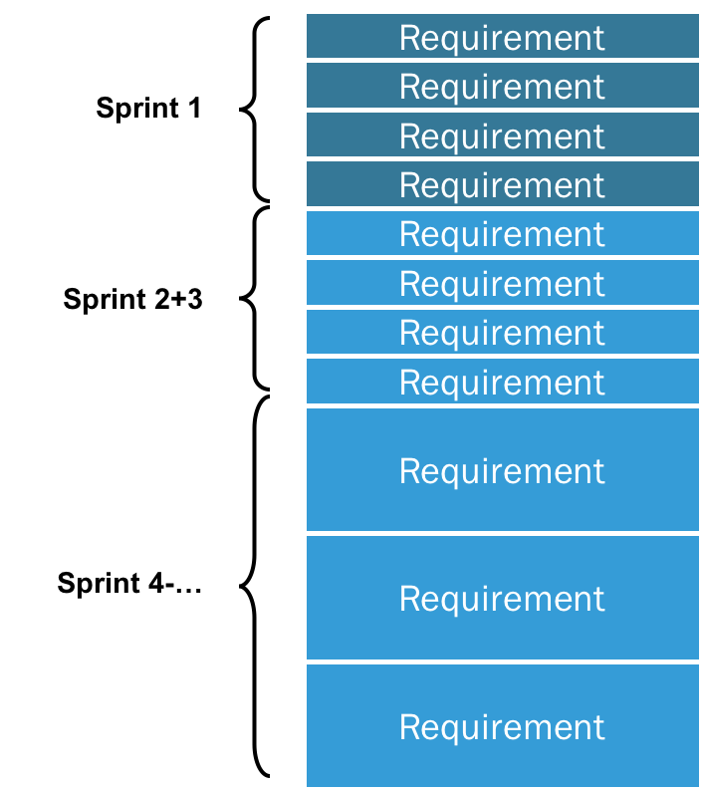
Product Backlog
The Product Backlog is an emergent, ordered list of what is needed to improve the product. It is the single source of work undertaken by the Scrum Team.
Product Backlog items that can be Done by the Scrum Team within one Sprint are deemed ready for selection in a Sprint Planning event. They usually acquire this degree of transparency after refining activities. Product Backlog refinement is the act of breaking down and further defining Product Backlog items into smaller more precise items. This is an ongoing activity to add details, such as a description, order, and size. Attributes often vary with the domain of work.
The Developers who will be doing the work are responsible for the sizing. The Product Owner may influence the Developers by helping them understand and select trade-offs. Multiple Scrum Teams often work together on the same product. One Product Backlog is used to describe the upcoming work on the product.

Slide 93
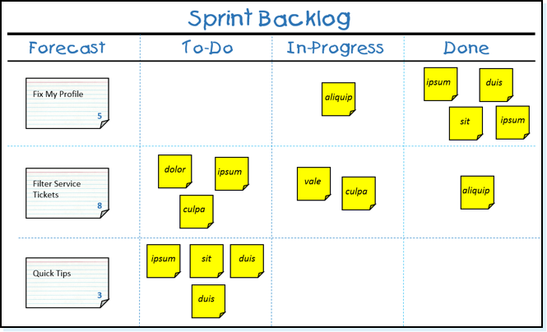
sprint Backlog
The Sprint Backlog is composed of the Sprint Goal (why), the set of Product Backlog items selected for the Sprint (what), as well as an actionable plan for delivering the Increment (how).
The Sprint Backlog is a plan by and for the Developers. It is a highly visible, real-time picture of the work that the Developers plan to accomplish during the Sprint in order to achieve the Sprint Goal. Consequently, the Sprint Backlog is updated throughout the Sprint as more is learned. It should have enough detail that they can inspect their progress in the Daily Scrum.

Slide 94

increment
An Increment is a concrete stepping stone toward the Product Goal. Each Increment is additive to all prior Increments and thoroughly verified, ensuring that all Increments work together. In order to provide value, the Increment must be usable.
Multiple Increments may be created within a Sprint. The sum of the Increments is presented at the Sprint Review thus supporting empiricism. However, an Increment may be delivered to stakeholders prior to the end of the Sprint. The Sprint Review should never be considered a gate to releasing value.
Work cannot be considered part of an Increment unless it meets the Definition of Done.

Slide 95
Definition of done
The Definition of Done is a formal description of the state of the Increment when it meets the quality measures required for the product.
The moment a Product Backlog item meets the Definition of Done, an Increment is born.
The Definition of Done creates transparency by providing everyone a shared understanding of what work was completed as part of the Increment. If a Product Backlog item does not meet the Definition of Done, it cannot be released or even presented at the Sprint Review. Instead, it returns to the Product Backlog for future consideration.
If the Definition of Done for an increment is part of the standards of the organization, all Scrum Teams must follow it as a minimum. If it is not an organizational standard, the Scrum Team must create a Definition of Done appropriate for the product.

Slide 96
DevOps?
SDLC Models

Slide 97
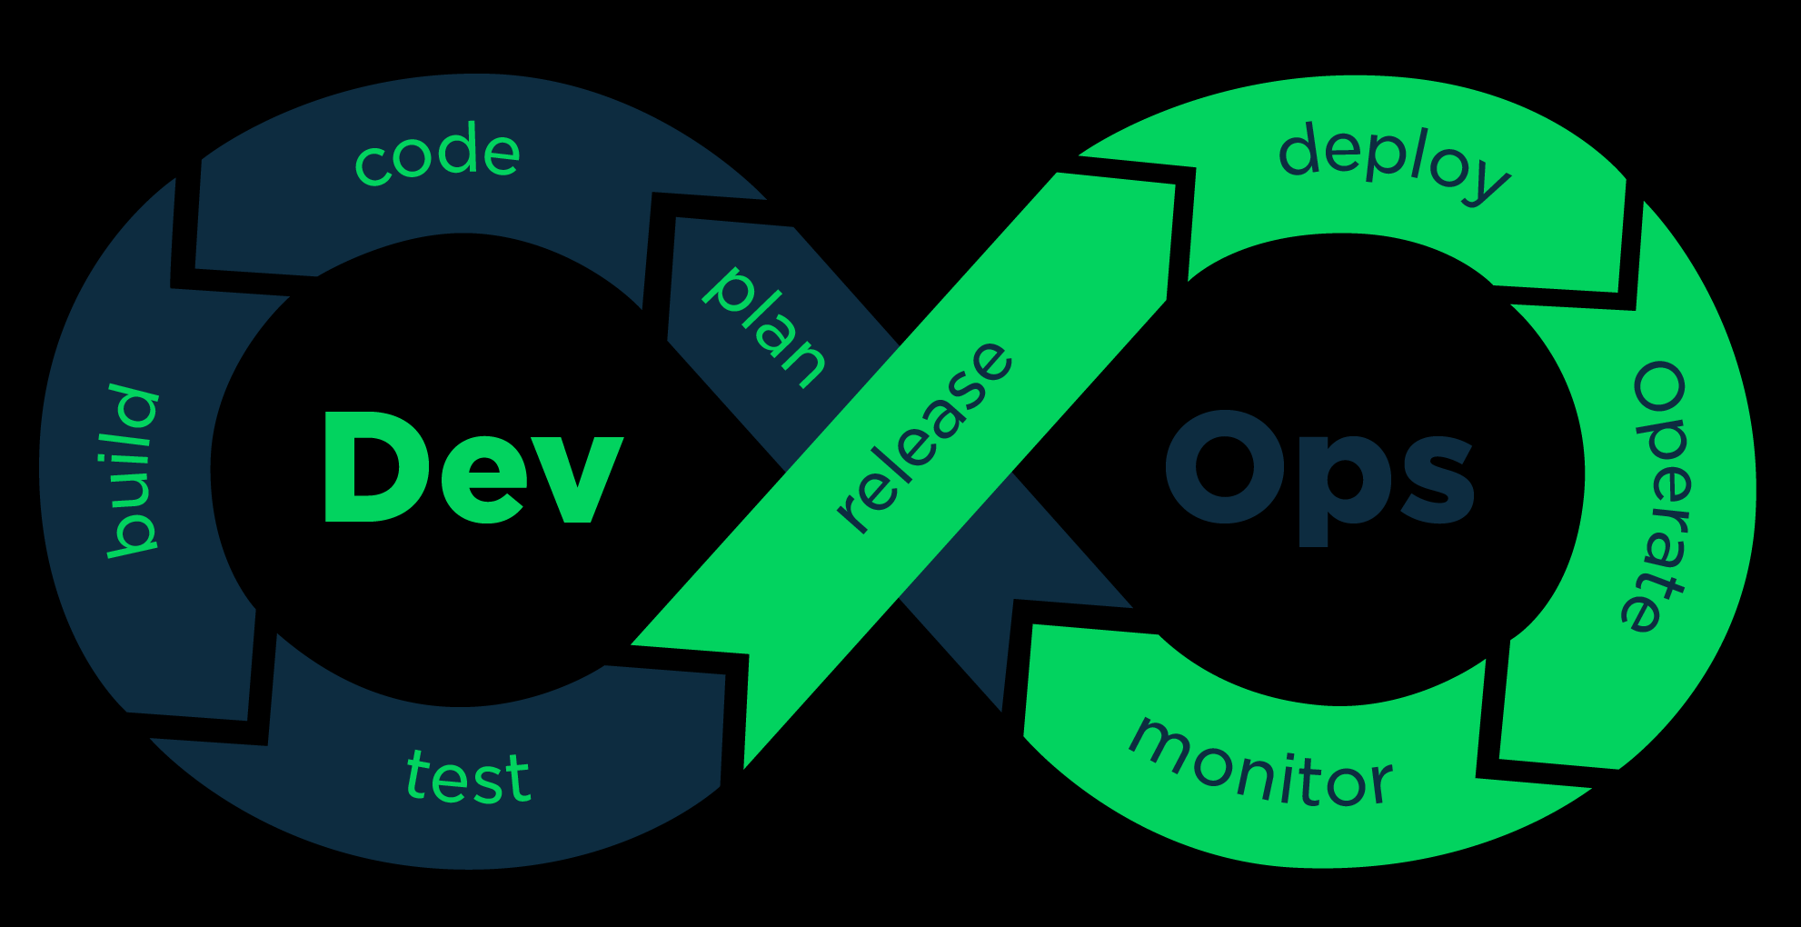

Slide 98
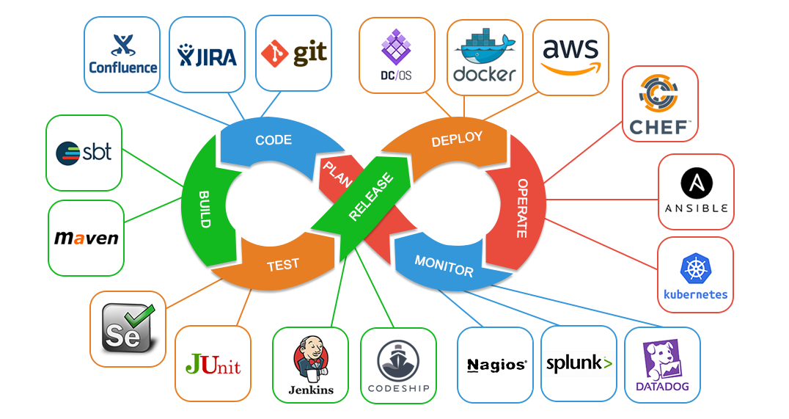

Slide 99
